Slide 1
Safe Back to School:
A practitioner’s guide
An inter-agency webinar by the east africa REGIONAL EiE working GROUP
Notes:
Include relevant branding/logos for other agencies
Introductions to panelists etc.
Very excited to be able to host this webinar as part of our launch of the Safe Back to School Practitioners Guide – an inter-agency guide that has been reviewed and endorsed by both the Global Education Cluster, the Child Protection Area of Responsibility and supported by the Inter-agency Network for Education in Emergencies (INEE).
Today we welcome so many of you to go hear more about the key elements of the guide and have the opportunity to ask us questions and grill our technical advisors on specific areas of the Guide.
Notify audience we are recording, ask participants to mute.

Slide 2
Forum Outline
Welcome & Overview: Emily Lugano, UNHCR
Safe Back-to-School Checklist
    MEAL: Daniel Kariuki, Save the Children
    Health: Dieudonne Yiweza T .S, UNHCR
    Nutrition: Naser Mohmand, UNHCR
    WASH: Robin Lloyd, UNHCR
    Education: Salome Ndemi Mullei, World Vision
    CP & MHPSS: Marco Grazia, World Vision
    Q&A
Country Example on School Reopening During COVID 19 – Tanzania: Girma Yadeta, UNHCR
Q&A
Notes:
Emphasise that we want this online forum to be interactive so please feel free to ask questions using your Mic or chat in the chat box and we will do our best to answer them for you.
We also will have an opportunity to hear from the country office on their experiences of preparing for a safe return to school – we want that part of the forum today to inspire you to also share your experiences at whatever stage you are at now – preparing to support schools to re-open or where you have already played a role in supporting the reopening already or just at the stage where it is still perhaps unclear what will happen.
Ask each facilitator to introduce themselves before they speak on their particular section (to save time at the beginning)

Slide 3
Safe Back to School: A unique opportunity!
INTEGRATION
TECHNICAL QUALITY
BUILD BACK BETTER
Notes:
(1min)
Integration -- being a shared priority across programmes, operations, technical, advocacy; COVID19 has highlighted how truly interconnected our sectors are, and this is an opportunity to work more efficiently and towards more impact for children if we work together
Technical quality --- This guide has been written drawing upon our best practices and experiences from previous responses like the Ebola crisis. By building on experience and evidence, we can make the COVID19 back to school experience much smoother and safer for children around the world.
Build back better: COVID19 surprised us! This is a change to get the foundations right for the next emergency – be it a health pandemic or another hazard like a cyclone or an outbreak of conflict.

Slide 4

Safe Back to School Guide Overview
Checklists
  Integrated Safe Back-to-School Checklist for Program Staff: 6-pager providing key actions for Health, Nutrition, WASH, M&E, Education and Child Protection/MHPSS sectors before and after schools reopen to ensure sectoral integration the school reopening process.
  School-Friendly Safe Back-to-School Checklist: 2-pager providing top line actions for a head teacher or school committee to follow.
Technical Annexes
  Participatory, inclusive back-to-school campaigns
  EdTech for absentee management systems
  Enable teachers in the transition back to school
  MHPSS for children as schools reopen
  Participatory education and continuity planning
  Adaptations for camp settings
  Advocacy messages
  Key considerations for Early Childhood Development (forthcoming)
Notes:
Integrated checklist:
Especially useful for project design and coordinated inter-sectoral planning (i.e. adaptations to the Humanitarian Response Plan) and for monitoring and oversight.
7 Technical Annexes: Annex 1 Participatory, inclusive back-to-school campaigns . Annex 2 Absence Management Systems . Annex 3 Enable teachers in the transition back to school . Annex 4 MHPSS for children as schools reopen . Annex 5 Participatory education and protection continuity planning . Annex 6 Adaptations for camp settings . Annex 7 Advocacy messages

Slide 5

Who should use this guide?
  You!
    Program teams
    Coordination teams
    Advocacy teams
  Together with partners!
    Inter-agency
    Inter-sectoral
    All contexts
Notes:
(1 min) Highlight the value of the guide being an interagency piece and how this changes how SC colleagues can use the guide
The guide aims to be a user-friendly, practitioner-focused tool that outlines the key steps needed for a coordinated, inclusive, all-hazards approach to school reopening and links to further guidance where appropriate.
Coordination teams (such as Child Protection Area of Responsibility, Education Cluster, EiE Working Group Coordinators, Refugee Education Groups or Local Education Groups) are encouraged to share this document and reference this guidance as coordinated school reopening strategies are developed and operationalized.
Highlight based on existing guidance/UN framework etc.

Slide 6
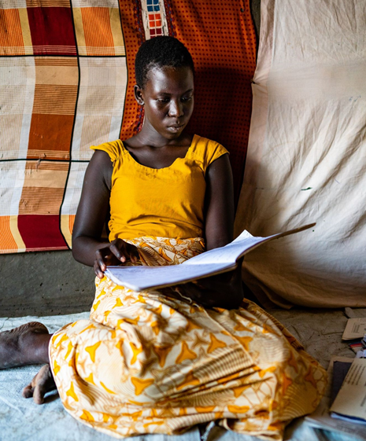
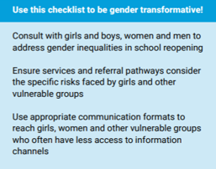
Key Principles for
Safe Back to School
An integrated approach
Child & youth participation
Gender, inclusion, and accessibility
Whole school community
Build on existing structures
Build back resilient
©Save the Children
Notes:
-emphasize that you can use this checklist to be gender transformative!

Slide 7
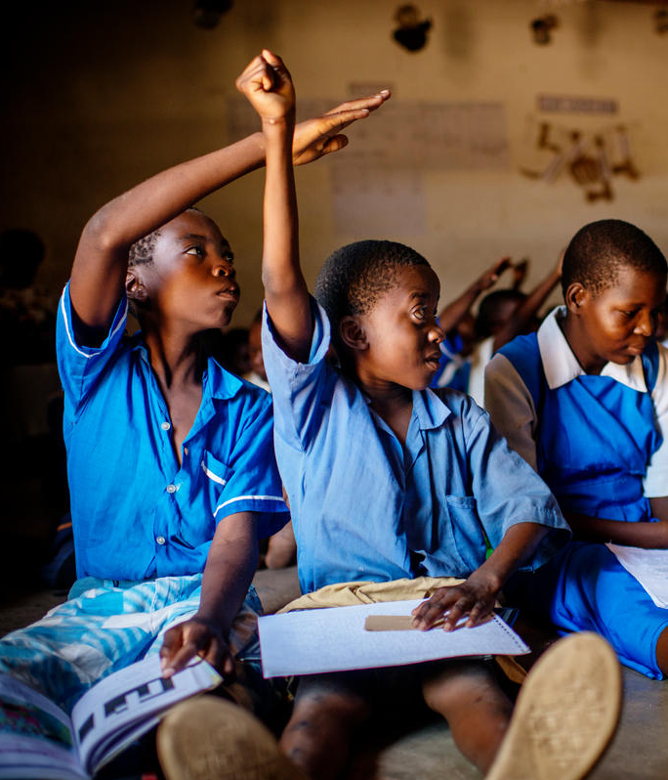
Integrated Safe Back-to-School Checklist for Program Staff
©Save the Children

Slide 8
Safe Back-to-School Checklist
MEAL
  Before Schools Reopen:
  Engage the whole community, including children and young people, in back-to school planning and campaigns using participatory methods.
    Use this Checklist to develop a participatory Safe Back to School monitoring tool to track progress with the whole school community. This can also be used to aggregate progress on reopening at district or national levels.
  After Schools Reopen:
  Conduct needs and gender assessment using participatory methods
    Conduct a rapid needs assessment on the education, CP/MHPSS, WASH and H&N needs now that schools have reopened. Assess how much children and young people continued learning during school closures and what support is needed to return to school.
  Refresh or establish accessible, gender and age-friendly accountability and feedback mechanisms
Notes:
Included bolded action points from the before schools reopen checklist and after schools reopen checklist

Slide 9
Safe Back-to-School Checklist
HEALTH/NUTRITION & WASH
  Before Schools Reopen:
  Clean and disinfect the school facilities with emphasis on surfaces that are touched by many people.
  Engage whole school community in cleaning and maintenance for school reopening
  After Schools Reopen:
  Ensure that cleaning and disinfection measures are effective and regular
    Encourage equal sharing of water sourcing and cleaning tasks between women and men.
  Educate children and young people about good hygiene, health, nutrition and menstrual hygiene.
  Increase air flow and ventilation
Notes:
Included bolded action points from the before schools reopen checklist and after schools reopen checklist

Slide 10
Safe Back-to-School Checklist
HEALTH – Guideline overview
  Objectives of Public Health are well highlighted in the guideline:
Prevent transmission ⬄ Care for those infected ⬄ Mitigate impact of pandemic
  Concept of “whole School Community “ very important as it highlights
Multisectoral approach ⬄ Integration (no stand alone action) ⬄ Participation (students not passive beneficiaries)
➔ Hygiene and sanitation:
need to motivate, train, equip ( PPEs, disinfectants)
➔ Coordination:
  Designate formally a focal point for school health within COVID-19 coordination platform at all levels, including at field levels
  School to attend COVID meetings and include an agenda item on school health
Notes:
Included bolded action points from the before schools reopen checklist and after schools reopen checklist

Slide 11
Safe Back-to-School Checklist
HEALTH – Guideline key points
Risk Communication and Community empowerment: awareness materials adapted to children
Properly equip schools based on government school health facility standards.
Stock schools with first aid kits, including PPE, thermometers and rubbing alcohol for cleaning thermometers.
Orient and train, give information on existing services and facilities
Establish proper recording and reporting of COVID-9 cases and other health information management, as recommended by governments
Connect schools with health facility for referrals
Identify temporary isolation areas for children/school staff who may be infected to safely wait before receiving care.
Notes:
Included bolded action points from the before schools reopen checklist and after schools reopen checklist

Slide 12
Safe Back-to-School Checklist
NUTRITION - Safe food preparation
      Where school meals or snacks were provided before schools closed, plan to restart provision as soon as possible. Due to COVID-19 many families need regular access to healthy meals as a matter of urgency. Where on-site distribution is not feasible, consider providing or increasing take-home rations.
      Procure nutrient-enhanced school feeding supplies if nutritional status of children and young people has significantly dropped.
      Plan to reopen school canteens to keep children and young people and staff safe: i.e. reduced capacity, protection measures for staff (see WFP/ FAO/UNICEF guidance, pages 7-8), staggered lunch hours, and hand washing before and after.
      Ensure that school canteens have safe water supply for drinking and hygiene, drinking water stations, handwashing facilities/stations with soap nearby, and proper waste disposal measures (e.g. trash bins, proper drainage).

Slide 13
Safe Back-to-School Checklist
EDUCATION
  Before Schools Reopen:
  Prepare school for physical distancing in, around, and on the way to schools
  Take action to ensure all children and young people return to school, prioritizing the most vulnerable
  Support school personnel well-being and train teachers on key topics and pedagogy to ensure a safe, quality return to school (see Technical Annex 3)
  After Schools Reopen:
  Prioritize psychosocial support and socio-emotional learning activities in the reopening period
    Include basic MHPSS or SEL activities into daily classroom routine (see Technical Annex 5)
  Identify additional learning needs (see Technical Annex 3)
  Prepare for recurring or future school closures
Notes:
Included bolded action points from the before schools reopen checklist and after schools reopen checklist
- Focus on checklist: presenting key elements and signposting (provide example of one or two key actions)
- Signposting technical annexes

Slide 14
Safe Back-to-School Checklist
CHILD PROTECTION/ MENTAL HEALTH AND PSYCHOSOCIAL SUPPORT (MHPSS)
  Before Schools Reopen:
  Prepare teachers and education personnel to meet the psychosocial and protection needs of children and young people and to manage their own health and wellbeing (see Technical Annex 3)
  Update/establish effective referral mechanisms
    Update school-based reporting and referral mechanisms for protection and health concerns, ensuring they are gender-sensitive, inclusive and age-appropriate adapted for COVID context if necessary. Test communication channels.
  Organize with child protection case workers and/or social workers to support school reopening
  After Schools Reopen:
  Ensure psychosocial support for children and young people, prioritizing girls and other vulnerable groups (see Technical Annex 4)
    Identify children and young people in high distress and/or with mental health conditions and refer them to specialized services. Coordination of MHPSS activities and referrals across sectors, including Education, CP and Health, is coordinated by MHPSS Technical Working Groups (where they exist) at country level).
Notes:
Included bolded action points from the before schools reopen checklist and after schools reopen checklist
We know that the impact of COVID-19 on the protection of children is significant both in terms of increased risk of violence and abuse due to confinement at home but also due to the inaccessibility of local child protection mechanisms, including those in the school, to monitor, report and respond to concerns children have.
So the actions included in the Guide related to Child Protection focus on:
BEFORE schools re-open:
Adapting school-based reporting and referral mechanisms
Ensuring continuity of referral to local child protection mechanisms and services
Information and advice to children and school staff if they have concerns about a child / another child
Facilitating coordination between education and child protection actors
AFTER schools re-open:
Ensuring school-based reporting and referral mechanisms are functioning (revitalising them if they are not)
Identifying children in need of support and/or referral
Delivering age-appropriate, gender and inclusion-sensitive messaging to prevent violence, abuse, bullying (as a result of stigma, for example)
Additional note on Technical Annex 3 – Enable teachers in the transition back to school- includes some specific guidance for teachers on identifying and reporting protection concerns – links to TPD module which focuses on psychological first aid, violence prevention and response.
Additional note on Technical Annex 5 – Participatory Education and Protection Continuity Planning –task presents a unique opportunity to re-visit protection risks, pre and post-COVID-19 and reassess school plans

Slide 15
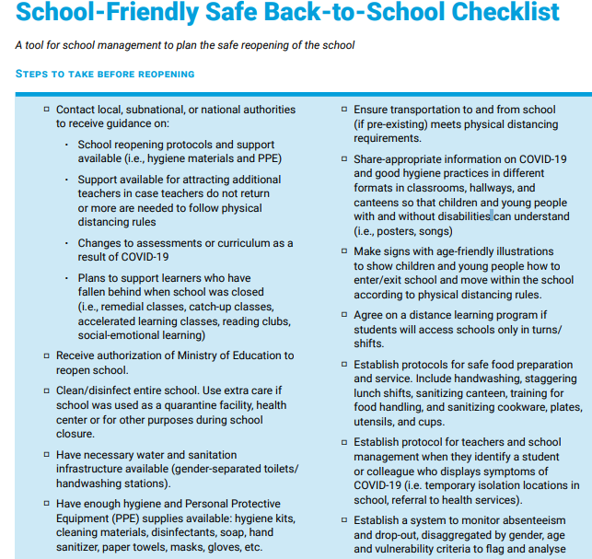
School-Friendly Safe Back-to-School Checklist for head teachers or school committees

Slide 16

Temperature Check!
On a scale of 0 to 1 000 000, how useful will this guide be for planning an integrated, safe return to school in your context?
0 = Totally useless!
1 000 000 = AMAZING!!!!!!

Slide 17
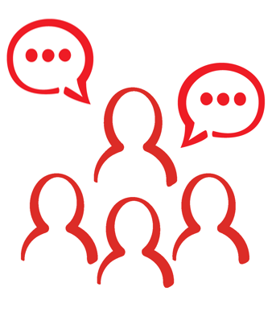
Q&A /
Discussion

Slide 18
Country Example: Tanzania
A Timeline in School Closures and Reopening
17 March: The Government announced closure of schools, universities and higher learning institutions
18 March: All schools closed
20 May: Government announced schools and universities will reopen on 01 June
27 May: Government published guidelines on prevention of COVID-19 in schools, HE
01 June: Schools (form 6) and HE institutions reopened
08 June: Refugee Schools (form 6) re-opened
29 June: To reopen all grade levels

Slide 19
Country Example: Tanzania
A Guidelines for Prevention of Transmission of COVID-19 in Schools and HE
The guideline focuses on 4 main areas:
- Preparation to be made before reopening schools, institutions
- Health screening
- Transport to and from schools/ colleges
- Teaching and Learning environment.

Slide 20
Country Example: Tanzania
School in Refugee Camps: Before Reopening
Coordinated by Refugee Education Working Group (EWG)
Reopened on June 8th, a week after the national schools
Reviewed the preparedness of schools before re-opening
62 schools and learning centres – some classrooms overcrowded (100 students)
Rehabilitated, upgraded WASH facilities
Identified WASH needs and gaps: resources mobilized to put in place WASH facilities

Slide 21
Country Example: Tanzania
School in Refugee Camps: Before Reopening
Conducted deep cleaning of school compounds, classrooms – under the supervision of WASH/Health professionals
Trained teaching and non-teaching school staff on COVID-19 prevention and first-aid and on first-aid kits
Prioritized in face mask distribution Students
All schools inspected- to ensure that schools meet the minimum requirement to reopen
Organized COVID prevention awareness session on the first day of school opening and proper use of face masks, social distancing

Slide 22
Country Example: Tanzania
School in Refugee Camps: After Reopening
Continued remobilization of students, youth into come back to schools
Teachers are planning on ways of condensing remaining lessons, catch up and remedial classes
The youth training program has adopted a double shift to be able to address the social distancing guideline.
Regular visit to schools by health sector to support teachers

Slide 23
Country Example: Tanzania
School in Refugee Camps: After Reopening
Challenges Observed After Schools Reopened
Teachers are worried of workload, overwork
Social distancing outside of classrooms not manageable
Use of face marks uneven - students complained discomfort on the use of face masks
Not all registered students returned to schools – among these are girls
Shortage of classrooms, furniture to decongesting classrooms

Slide 24
Q&A /
Discussion

Slide 25

WE WANT TO HEAR FROM YOU!
Share your best practices and adaptations!
Want to know more?
(include email contacts)

Slide 26

THANK YOU!
Notes:
Include relevant branding/logos for other agencies

